Slide 2

Automation using Protractor - Session 2
- Abhay Singh - Reetika Nigam

Slide 3
Brief Outline
Protractor Commands
Jasmine Framework
Promise in Protractor
Assertions
Hooks
Page Object Model
Calculator Demo Application
Hands on

Slide 4
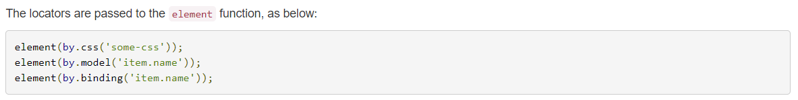
Protractor Commands
Global Variables -
browser : A wrapper around an instance of WebDriver, used for navigation and page-wide information. The browser.get() method loads a page. Protractor expects Angular to be present on a page. For non-angular, you may access the wrapped webdriver instance directly with browser.driver
element : A helper function for finding and interacting with DOM elements on the page you are testing. The element function searches for an element on the page.
by - A collection of element locator strategies. For example, elements can be found by CSS selector, by ID, or by the attribute they are bound to with ng-model.
Locator Strategy –
Protractor exports a global function element, which takes a Locator and will return an ElementFinder. This function finds a single element - if you need to manipulate multiple elements, use the element.all function.

Slide 5
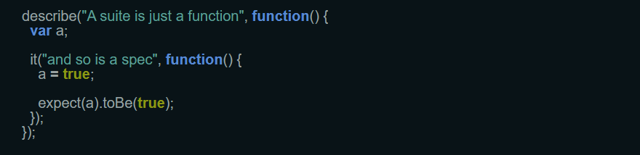
Jasmine Framework
Jasmine test case consist of suites and specs.
Suites(describe Your Tests) : The describe function is for grouping related specs, typically each test file has one at the top level. Naming the collection of specs,and will be concatenated with specs to make a spec's full name. This aids in finding specs in a large suite.
Specs(it blocks) : takes a string and a function. The string is the title of the spec and the function is the spec, or test. A spec contains one or more expectations that test the state of the code.

Slide 6
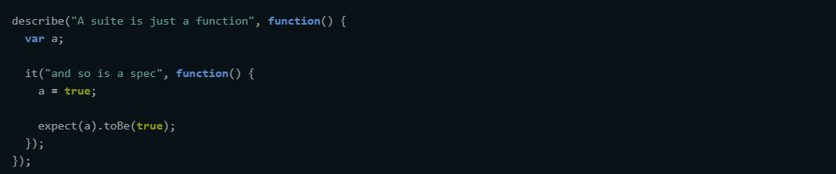
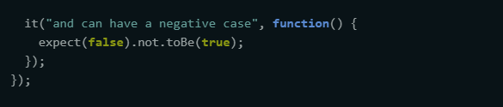
Assertions in Jasmine
Expectations :
Expectations are built with the function expect which takes a value, called the actual. It is chained with a Matcher function, which takes the expected value.
Each matcher implements a boolean comparison between the actual value and the expected value. It is responsible for reporting to Jasmine if the expectation is true or false. Jasmine will then pass or fail the spec.
https://jasmine.github.io/2.0/introduction.html

Slide 7
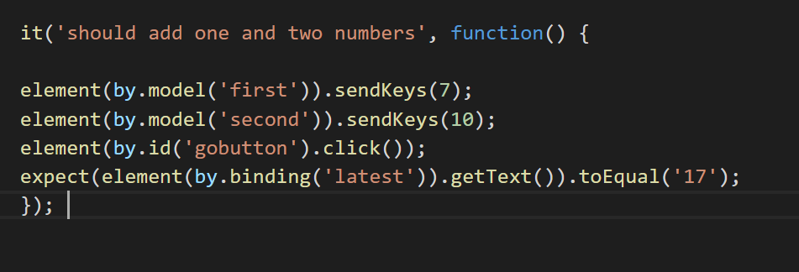
Promises and Control Flow
JavaScript is asynchronous.
A promise is an object that represents the eventual completion (success or failure) of an asynchronous operation and its resulting value. That means the object that will be resolved in the future. In short, the promise will have a value that is not ready to use immediately but you can use it once the promise is resolved.
PENDING, RESOLVED, REJECTED.

Slide 8
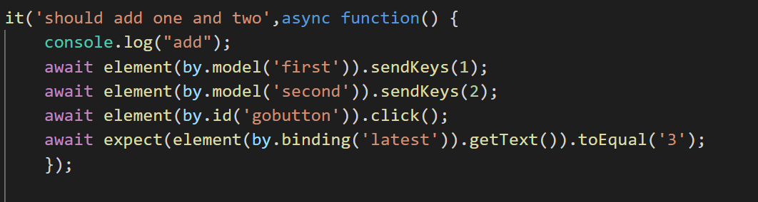
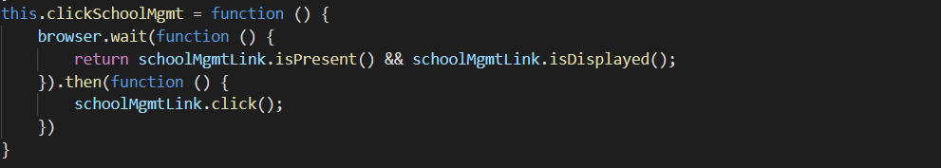
Await/browser.wait()
There’s a special syntax to work with promises in a more comfortable fashion, called “async/await”. It’s surprisingly easy to understand and use.

Slide 9
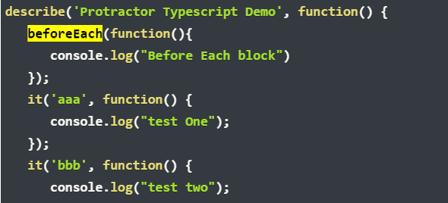
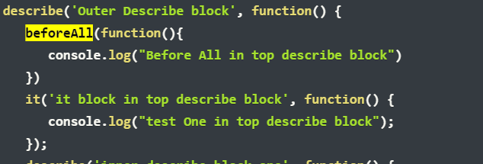
Hooks
beforeEach(): function that runs before every it() block.
https://jasmine.github.io/api/3.3/global
beforeAll(): The beforeAll block will be executed before executing any it() or describe() block inside a describe block.

Slide 10
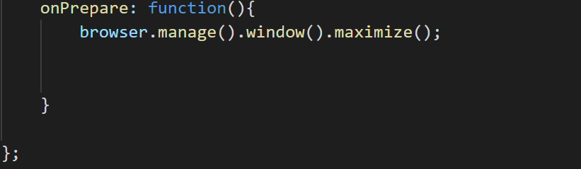
onPrepare() onComplete(): try at your end.
onPrepare function, which will be run once before any of your tests.

Slide 11
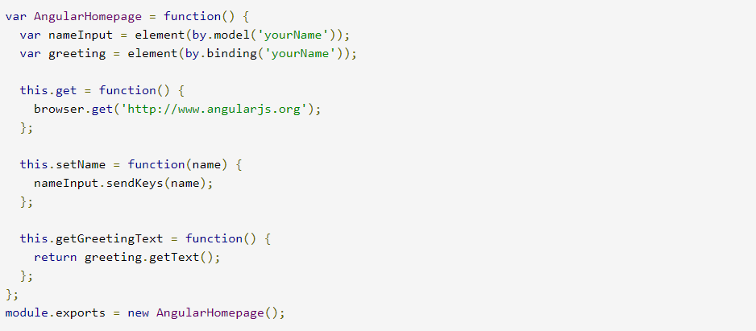
Page Object Model
Page Objects help you write cleaner tests by encapsulating information about the elements on your application page. A Page Object can be reused across multiple tests, and if the template of your application changes, you only need to update the Page Object.

Slide 12
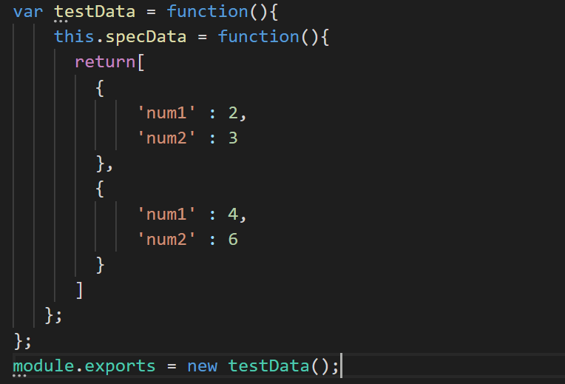

Data Providers
It helps you to write data-driven tests which essentially means that same test method can be run multiple times with different data-sets.

Slide 13
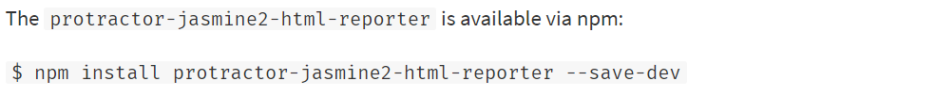
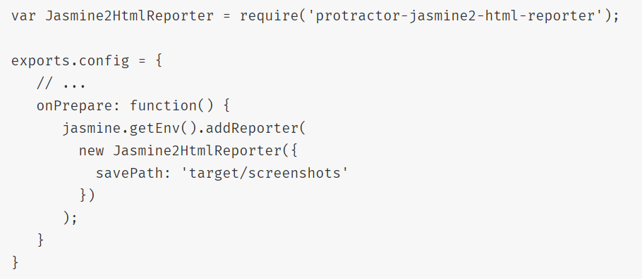
Reporting
HTML reporter for Jasmine2 and Protractor that will include screenshots of each test if you want.

Slide 14


Slide 15
Quality at the speed of digital Thank YOU

